Slide 1
Ethernet LANs
Prepared By: Er. Amit Kr Tewari
Associate Professor
CS Dept.
ACEIT, Jaipur

Slide 2
History
One of the oldest and by far the most widely used of all LANs is Ethernet.
Ethernet, which was developed by Xerox Corporation at Palo Alto Research Center in the 1970s.
In 1980, Xerox joined with Digital Equipment Corporation (now part of HewlettPackard) and Intel to sponsor a joint standard for Ethernet.
The collaboration resulted in a defi nition that became the basis for the IEEE 802.3 standard.

Slide 3
Topology
The original versions of Ethernet used a bus topology.
Today, most use a physical star configuration.
Each node uses a twisted-pair cable to connect into a centrally located hub or switch.
The switch is then connected to a router or gateway that provides access to the services needed by each user.

Slide 4
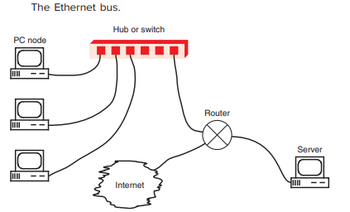

Slide 5
Encoding
Ethernet uses baseband data transmission methods.
This means that the serial data to be transmitted is placed directly on the bus media.
Before transmission, however, the binary data is encoded into a unique variation of the binary code known as the Manchester code

Slide 6
Speed
The standard transmission speed for original basic Ethernet LANs is 10 Mbps.
A more widely used version of Ethernet is called Fast Ethernet. It has a speed of 100 Mbps.
Other versions of Ethernet run at speeds of 1 Gbps or 10 Gbps, typically over fiber-optic cable but also on shorter lengths of coaxial or twisted-pair cable.
The most common version of Ethernet today is Gigabit Ethernet (GE), which is essentially an integral part of every PC and laptop.

Slide 7
Transmission Medium
The original transmission medium for Ethernet was coaxial cable.
However, today twisted-pair versions of Ethernet are more popular.
The two main types of coaxial cable used in Ethernet networks are RG-8/U and RG-58/U
Ethernet systems using thick coaxial cable are generally referred to as 10Base-5 systems, where 10 means a 10-Mbps speed.
More recent versions of Ethernet use twisted-pair cable.
The twisted-pair version of Ethernet is referred to as a 10Base-T network, where the T stands for twisted-pair.

Slide 8
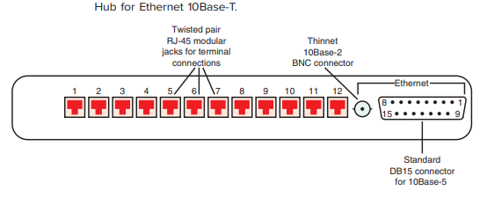
Hub for Ethernet 10Base-T

Slide 9
100-Mbps Ethernet
Several 100-Mbps versions have been developed including 100Base-T or 100Base-TX, also called Fast Ethernet, 100VG-AnyLAN, 100Base-T4, and 100Base-FX.
All use twisted-pair cable except the FX version, which uses fiber-optic cable.
The TX and FX methods use the carrier sense multiple access with collision detection (CSMA/CD) access method.

Slide 10
100-Mbps Ethernet
The 100VG-AnyLAN and -T4 versions use unique access methods.
Most, if not all, NICs support 10-Mbps, 100-Mbps, and 1-Gbps rates.
By far the most popular version of 100-Mbps Ethernet is 100Base-TX, or Fast Ethernet.
It uses two unshielded twisted pairs instead of the single pair used in standard 10Base-T.
One pair is used for transmitting, and the other is used for receiving, permitting full duplex operation, which is not possible with standard Ethernet.

Slide 11
100-Mbps Ethernet
To achieve such high speeds on UTP, several important technical changes were implemented in Fast Ethernet:
Cable length is restricted to 100 m of category 5 UTP (minimal inductance, capacitance, and resistance)
Second, a new type of encoding method is used. Called MLT-3
As for access method, 100Base-T uses CSMA/CD. Most 100-Mbps Ethernet systems use the 100Base-T format described here.
100Base-FX is a fiber-optic cable version of Ethernet.

Slide 12
Gigabit Ethernet
Gigabit Ethernet (1 GE) is capable of achieving 1000 Mbps or 1 Gbps over category 5 UTP or fiber-optic cable.
The 1-Gbps speed is more readily achieved with fiber-optic cable, but it is more expensive.
The UTP version of Gigabit Ethernet is defined by the IEEE standard 802.3ab and is generally referred to as 1000Base-T.

Slide 13
Gigabit Ethernet
2 bits is transmitted for each baud or symbol level, the data rate on each twisted pair is 250 Mbps.
Together, the four pairs produce a composite data rate of 4 3 250 5 1000 Mbps or 1 Gbps.
Maximum distance is 100 m.
The CSMA/CD access method is used, and communication can be half or full duplex.

Slide 14
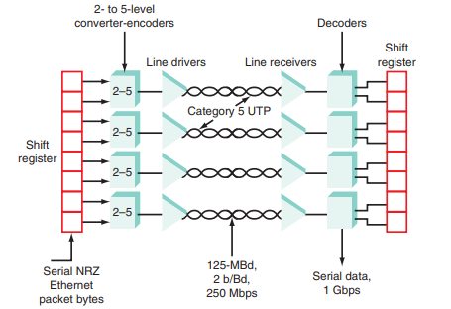
Gigabit Ethernet

Slide 15
Fiber-Optic Cable Versions of Gigabit Ethernet
Defined under the IEEE 802.3z standard.
All data transmissions are serial, unlike transmissions with the 1000Base-T UTP version.
The 1000Base-LX version uses a single-mode fiber (SMF) cable with a diameter of 9 μm and a transmitting laser operating at an infrared wavelength of 1310 nm.
It can achieve 1 Gbps on a cable length to 10 km.
When the larger, less expensive multimode fiber (MMF) is used, the maximum operating distances are 550 m with 50-μm-diameter fiber and 500 m with 62.5-μm-diameter fiber.

Slide 16
10-Gbit Ethernet
An even faster version of Ethernet is 10-Gbit Ethernet (10GE), which permits data speeds up to 10 Gbps over fiber-optic cable as well as higher grades of twisted-pair.
The defining IEEE standard is 802.3ae.
Three of the five variations use serial data transmission.
The other two use what is called wide-wavelength division multiplexing (WWDM).

Slide 17
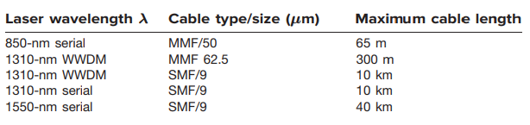
10-Gbit Ethernet

